Slide 1
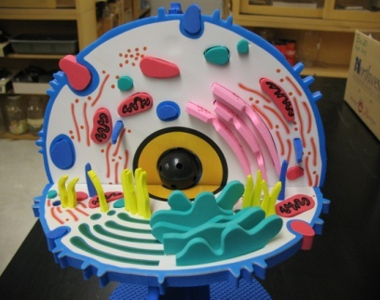
Mrs. Demet’s 7th Grade Life Science Class
The Basic Units of Life are CELLS!
Notes:
This information in this presentation should be important to everyone because if you don’t have cells, you don’t have life!!

Slide 2
Characteristics of Living Things
Have cells
Sense change
Can respond to change
Reproduce
Have DNA
Use energy
Grow and develop
Notes:
Living things have certain attributes. Look around the room right now.. It is easy to distinguish which things are living and which things are not.

Slide 3
ROBERT HOOKE
17th Century Man
Scientific Innovator
Notes:
Once in a great while a human being reaches deep inside him or herself and makes a great scientific discovery. This man built his own microscope in the 1600’s and discovered plant cells.

Slide 4
ROBERT HOOKE
His Sketch of Cork
Today’s Look at Plant Cell
Notes:
As you can see the first sketches made by Hooke in the 1600’s differ greatly from the images of cells available to see today with electron microscopes and digital imaging.

Slide 5
The Cell Theory
All organisms are made of one or more cells.
The cell is the basic unit of all living things.
All cells come from existing cells.
Notes:
The Cell Theory has three parts. You should familiarize yourself with this theory because you will see this theory again and again during your education. It is in your best interest to learn and understand this theory.

Slide 6
There are Only Two Types of Cells
Prokaryotes
Eukaryotes
Has nucleus
Thank you Cellupedia
Notes:
Click on type to find out more.

Slide 7
Similarities & Differences
Prokaryotic Cells
Eukaryotic Cells
Notes:
There are 2 types of Prokaryotes: Eubacteria and Archaebacteria. All cells have DNA, cell membranes, organelles, and cytoplasm. The differences however are that prokaryotes are single-celled, have no nucleus, and are eubacteria and archaebacteria. A eukaryote is single or multi-cellular, has a nucleus, and are plant, animal, or fungi.

Slide 8
Similarities & Differences
Plant Cells
Animal Cells
Notes:
These pictures illustrate how typical plant and animal cells differ in appearance. Plant cells have cell walls, cellulose, and chloroplasts. Animal cells do not have cell walls, cellulose or chloroplast.

Slide 9
Click Here to Learn More About Plant & Animal Cells

Slide 10
Organelles
Nucleus
Chloroplasts

Slide 11
Organelles
Ribosome
Golgi Complex

Slide 12
Organelles
Endoplasmic Reticulum
Vacuole

Slide 13
Organelles
Mitochondria
Lysosome

Slide 14
Click on the Following Links: Link 1 Link 2

Slide 15
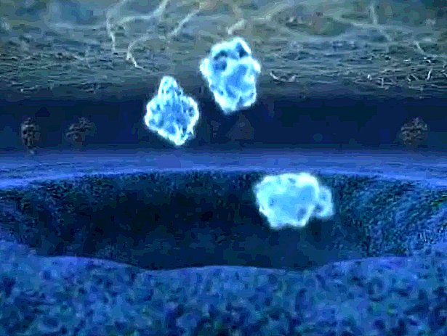
The End Thank You for Watching
Coming Soon
The Cell in Action

